Slide 1
CS 3305A
Memory Management
Lecture 17

Slide 2
Agenda
Intro: Memory management in OS
Memory hierarchy
Address binding
Memory allocation techniques
Contiguous Memory Allocation
Fixed and Dynamic Allocations
Paging Concepts

Slide 3
Introduction
Previous memory schemes were characterized by
Internal / External fragmentation
Need for compaction for External fragmentation
Paging is a memory management technique that avoids external fragmentation and compaction

Slide 4
Paging
Partition physical memory into small equal-size chunks and divide a process’s logical memory into the same size chunks
The chunks of a process are called pages and chunks of memory are called frames
When a process is to be executed, its pages are loaded (from a file system) into any available memory frames
A page/frame is associated with a set of memory addresses

Slide 5
Paging
An operating system maintains a page table for each process
Contains the frame location for each page of a process

Slide 6
Page Example
Frame
Number
0
A0
1
A1
0
0
0
7
2
A2
1
1
1
9
A3
3
2
2
2
11
4
3
3
Process B
5
6
Process A
7
B0
Page Tables
Every process has a page table
Each page table has page indexes/numbers and associated frame index / number
8
9
B1
10
11
B2
12
13
14

Slide 7
Address Translation Scheme
Logical address generated by CPU is divided into:
Page number (p) – used as an index into a page table which contains the frame number
Page offset (d) – determines the location in the page which is needed to determine the location in the frame

Slide 8
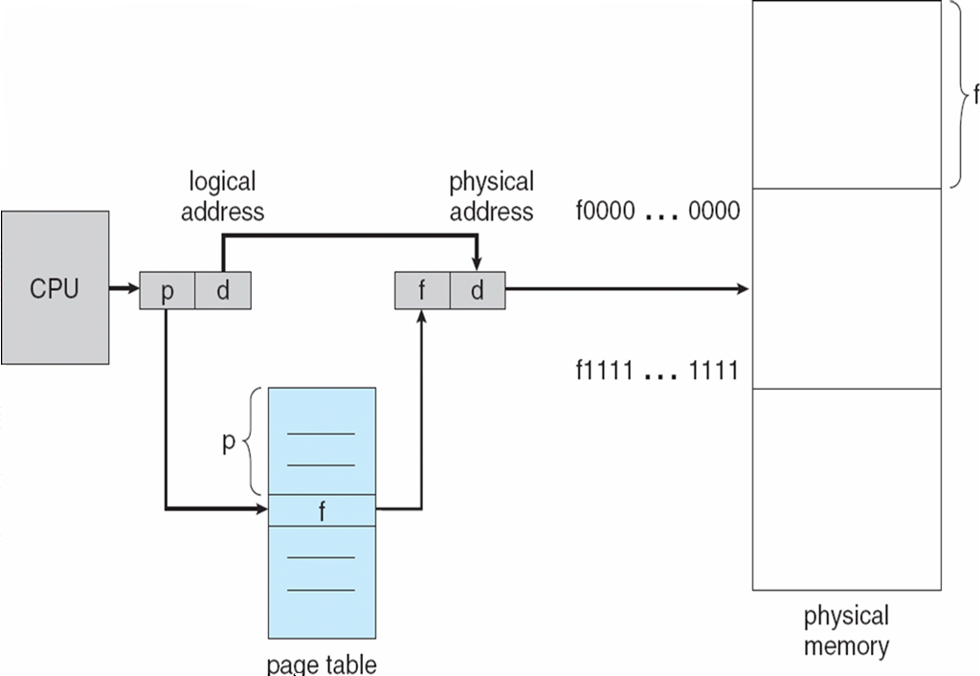
Paging Hardware – Memory Management Unit (MMU)

Slide 9
Logical to Physical Address Translation
CPU Wants to access a specific location in process B
(Assume page size is 10 units: 0 to 9)
Requested Logical Address
Process B, Page 1, Offset 3
(i.e., line number 3 within page 1)
0
A0
A
1
A1
0
1
2
3
2
A2
0
1
2
3
3
A3
Logical Address for Process B
Page Number: 1, Offset: 3
4
5
C0
6
B
7
B0
0
1
2
7
9
11
8
Frame Number: 9 | Offset: 3
9
B1
10
C
11
B2
MMU
0
1
5
14
12
13
14
C1
Page Tables

Slide 10
Address Translation Scheme
If the number of logical address bits is m and the number of bits to represent page numbers is n:
Logical address space: 2^{m}
Page numbers: 2^{n}
Page size (number of entries in page) is 2^{(m-n)}
Example: m = 4, n = 2, m – n = 2
Number of addresses is: 2^4 = 16
Page numbers / indexes: 2^2 = 4
Page size / number of entries in a page is 2^2 = 4
Example: m = 4, n = 3, m – n = 1
Number of addresses is: 2^4 = 16
Page numbers / indexes: 2^3 = 8
Page size / number of entries in a page is 2^1 = 2

Slide 11
Paging Hardware – Memory Management Unit (MMU)

Slide 12
Paging Hardware
The CPU issues a logical address (remember that all addresses are binary)
The hardware extracts the page number, p, and the page offset d
The page number, p, is used to index the page table
The entry in the page table consists of the frame number, f
The actual address is the concatenation of the bits that make up f and d.

Slide 13
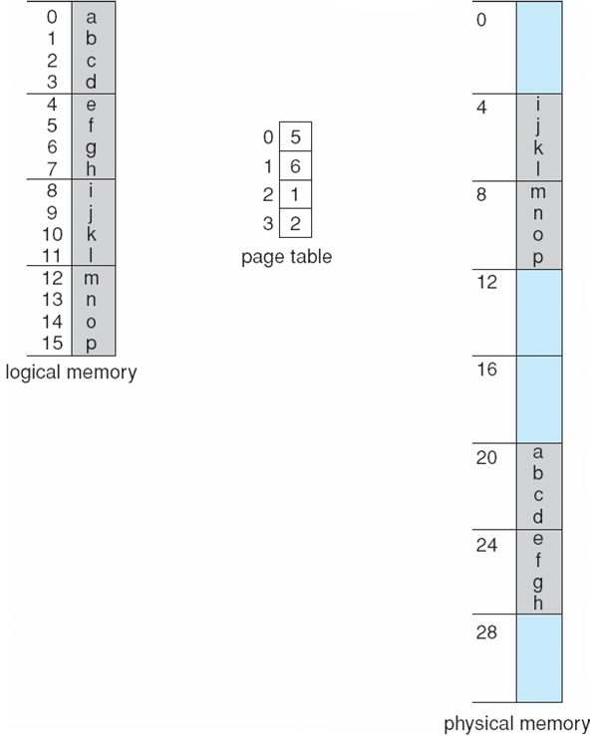
Paging Example
0
1
2
3
0
1
2
3
4
5
6
7
m=4 bits
n (bits for page numbers, p) = 2 bits
m – n (bits for page size, d) = 2 bits
Logical memory: 16 bytes
# pages: 4
Page size: 4 bytes
Physical memory: 8 frames (32 bytes)

Slide 14
Paging Example
First a little reminder. All addresses are in bits. The example on the previous page gives the base 10 equivalent of binary numbers
0 | 0000
1 | 0001
2 | 0010
3 | 0011
4 | 0100
5 | 0101
6 | 0110
7 | 0111
8 | 1000
9 | 1001
10 | 1010
11 | 1011
12 | 1100
13 | 1101
14 | 1110
15 | 1111

Slide 15
Example #1
Logical address in binary form is 0000
From the bits we extract the page number as 00 and the offset as 00
Page number 00 corresponds to the first entry of the page table.
There we find that the corresponding frame is 5 (or 0101)
The physical address produced is the concatenation of the bits of the frame number and the offset
010100
In base 10 we find that the physical address is 20

Slide 16
Example #2
Logical address in binary form is 0101
From the bits we extract the page number as 01 and the offset as 01
Page number 01 corresponds to the second entry of the page table.
There we find that the corresponding frame is 6 (or 0110)
The physical address produced is the concatenation of the bits of the frame number and the offset
011001
In base 10 we find that the physical address is 25(6*4+1)

Slide 17
Observations
Let’s look at logical addresses:
0000 (0), 0001 (1), 0010(2) and 0011(3)
The first two bits (page number) are the same
This means that these logical addresses will be in the same frame.
The position in the frame is determined by the offset

Slide 18
Observations
There may be some internal fragmentation
The last frame allocated may not be completely full

